Slide 1
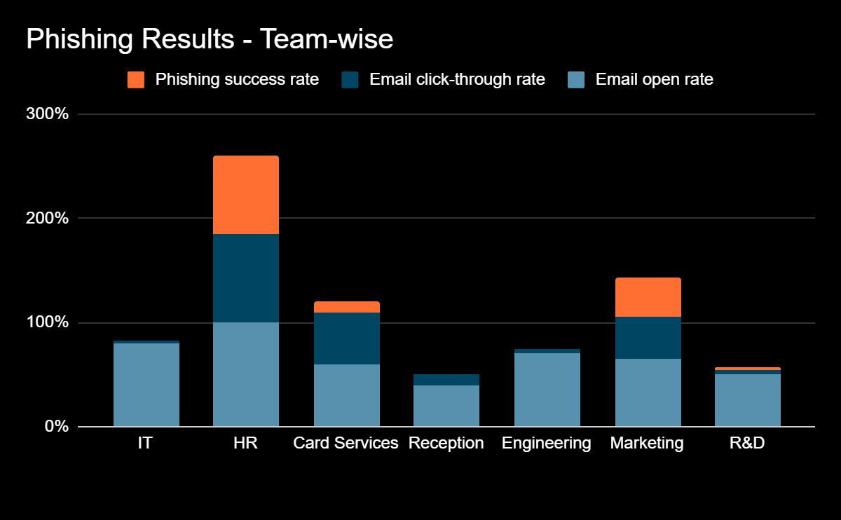
Familiarize yourself with phishing attacks
Avg open rate Avg click-through rate Avg phishing success
66% 28% 18%
75%
85%
10%
38%
2%
50%
4%
40%
10%
2%
5%
80%
100%
60%
70%
65%
50%
40%
HIGH RISK
HR (75%)
MARKETING (38%)
MEDIUM RISK
CARD SERVICES (10%)
LOW RISK
IT (0%), R&D (2%),
ENGINEERING (1%), RECEPTION (0%)

Slide 2
What is phishing?
Phishing is a type of cyber attack where an attacker impersonates a trusted person or organization to trick individuals into revealing sensitive information such as passwords, financial details, or personal data.

Slide 3








Learn to spot phishing emails
Respecting boss/police
E.g. Fake CEO emails
Routine blindness
E.g. Fake standard invoices
FAMILIARITY
AUTHORITY
Helping the distressed
E.g. Stranded traveller
URGENCY/SCARCITY
Act now, or lose out
E.g. Account Suspension
SYMPATHY
Baby steps first
E.g. Confirm email first → Then send money
COMMITMENT
LIKING
Trusting friendly people
E.g. Shared Hobbies
Too tired to think
E.g. Late Friday request
OVERLOAD
SOCIAL PROOF
Following the crowd
E.g. Everyone else did it

Slide 4
How do we stop getting phished?
Verify the sender
Don’t click suspicious links
Think before you act

